Slide 1
EMAIL SPAM CLASSIFIER
Submitted by
KAYALVIZHI . P

Slide 2
AGENDA
Overview
Problem Statement.
Problem Understanding.
Importance of Malignant Comments Classification.
Exploratory Data Analysis (Steps).
Visualizations.
Word Clouds.
Data Analysis Steps.
Model Building and Cross Validation Scores.
Saving the model and predicting the results.
Conclusion.

Slide 3
OVERVIEW
In this particular presentation we will be looking at:
How to analyze the dataset of EMAIL SPAM CLASSIFIER.
What are the EDA steps in cleaning the dataset.
Overall analysis on the problem.
Model building from the cleaned dataset.
Predictions for test dataset from saved model.

Slide 4
PROBLEM STATEMENT
In today’s globalized world, email is a primary source of communication. This communication can vary from personal, business, corporate to government. With the rapid increase in email usage, there has also been increase in the SPAM emails. SPAM emails, also known as junk email involves nearly identical messages sent to numerous recipients by email. Apart from being annoying, spam emails can also pose a security threat to computer system. It is estimated that spam cost businesses on the order of $100 billion in 2007. In this project, we use text mining to perform automatic spam filtering to use emails effectively. We try to identify patterns using Data-mining classification algorithms to enable us classify the emails as HAM or SPAM.

Slide 5
At least 97% of American use text messages over mobile phones every day. In 2016, according to the research conducted by Portio research, 8.3 trillion messages exchanged over the mobile phones. The rising flood of big data shows an exchange of 23 billion messages per day and 16 million messages per minute. There are around 6.4 billion mobile subscribers around the world by the end of 2012. According to Portio Research, there will be a CAGR growth of 4.8% of growth in mobile subscriber base from 2014 to 2017. By the end of 2017, the mobile subscriber reached to 7.4 billion mobile subscribers. The proliferation of smart devices powered by exponential computing has shown a significant rise in the global smartphone system-on-chip market lead by Qualcomm, Apple, MediaTrek, Samsung, HiSilicon, Spreadtrum, and a vast number of other smartphone chip manufacturers in the market.

Slide 6
PROBLEM UNDERSTANDING
In the past few years, it is seen that the cases related to social media hatred have increased exponentially. The social media is turning into a dark venomous pit for people now a days. Online hate is the result of difference in opinion, race, religion, occupation, nationality etc. In social media the people spreading or involved in such kind of activities uses filthy languages, aggression, images etc. to offend and gravely hurt the person on the other side. This is one of the major concerns now.
The result of such activities can be dangerous. It gives mental trauma to the victims making their lives miserable. People who are not well aware of mental health online hate or cyber bullying become life threatening for them. Such cases are also at rise. It is also taking its toll on religions. Each and every day we can see an incident of fighting between people of different communities or religions due to offensive social media posts.

Slide 7
IMPORTANCE of SMS SPAM CLASSIFIER
Every day, we get a tremendous amount of short content data from the blast of online correspondence, web-based business and the utilization of advanced gadgets. This volume of data requires text mining apparatuses to carry out the various report tasks in an opportune and suitable way. Detecting and controlling verbal AND fake abuse in an automated fashion is inherently an NLP task (Natural Language Processing). Text Classification is a great point for NLP.
Nowadays, every email and short messaging service and applications use machine learning approach. Machine Learning has simplified the task that may take long duration to complete without it. Most of the approaches require text analysis and classification techniques. Classification of the comments is necessary before posting on online platforms. This classification model helps to prevent the online abuse and cyber bullying.

Slide 8
EXPLORATORY DATA ANALYSIS
Importing necessary libraries and importing the Train & Test datasets.
Checked some statistical information like shape, number of unique values present, info, finding zero values etc on both the datasets.
Checked for null values and did not find any null values In both datasets. And removed Id.
Conducted some feature engineering and created new columns via label: which contain both good and bad comments which is the sum of all the labels, comment length: which contains the length of comment text.
Visualized each feature using seaborn and matplotlib libraries by plotting categorical plots like pie plot, count plot, distribution plot and word cloud for each label.

Slide 9
Done text pre-processing techniques like Removing Punctuations and other special characters, Splitting the comments into individual words, Removing Stop Words, Stemming and Lemmatization.
Then created new column as clean _length after cleaning the data.
All these steps were done on both train and test datasets.
Checked correlation using heatmap.
After getting a cleaned data used TF-IDF vectorizer.
Lastly, proceeded with model building.

Slide 10

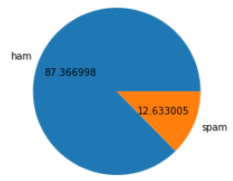
VISUALIZATIONS
OBSERVATIONS:
From the pie chart we can notice approximately 87.3 % of the MESSAGE are HAM, 12.6% of the MESSEAGE are SPAM.

Slide 11
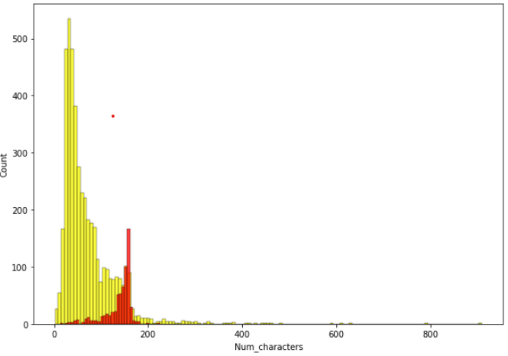
The Yellow lines shows the Num_characters of HAM messages, Red lines shows the Num_characters SPAM messages.

Slide 12
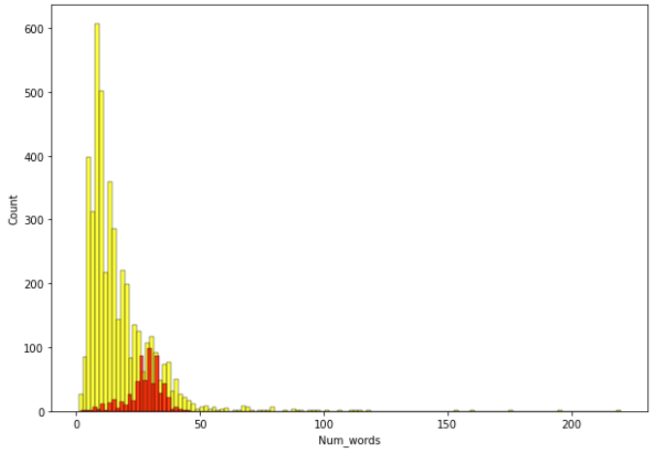
The Yellow lines shows the Num_words of HAM messages, Red lines shows the Num_words SPAM messages.

Slide 13
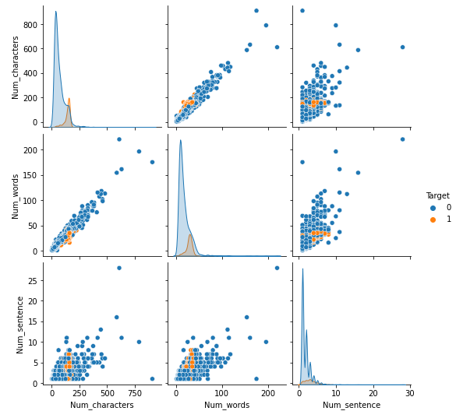
The graph is the pairplot to show the relation between Num_characters, Num_words, Num_sentence.

Slide 14
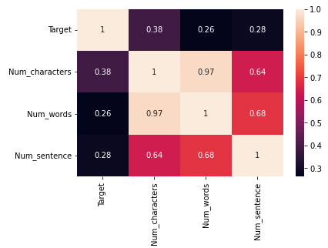
Num_words is highly positively correlated with Target.

Slide 15
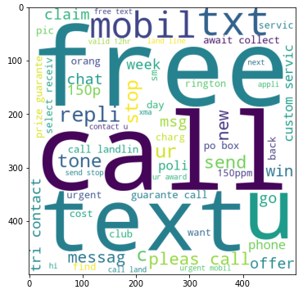
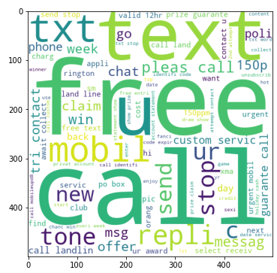
These are the toxic words which frequently appear in the Malignant column.

Slide 16
DATA ANALYSIS STEPS
I have extracted some features and removed the feature “Id” to improve data normality and linearity.
Done text pre-processing techniques like: Removing Punctuations and other special characters, Splitting the comments into individual words, Removing Stop Words, Stemming and Lemmatization.
Then created new column as clean_length after cleaning the data.
All these steps were done on both train and test datasets.
Used Pearson’s correlation coefficient and heat map to check the correlation.
After getting a cleaned data used TF-IDF vectorizer. It’ll help to transform the text data to feature vector which can be used as input in our modelling.
Balanced the data using Random-oversampler mechanism.
Split train and test to build machine learning models.
Model building process will be shown in the further steps.

Slide 17
MODEL BUILDING
In this project there were 6 features which defines the type of comment like Text, Num_characters, Num_words, Num_sentence, transformed_text but we created another feature named as “Target” which is combined of all the above features and contains the labeled data into the format of 0 and 1 where 0 represents “HAM” and 1 represents “SPAM”.
In this NLP based project we need to predict the multiple labels which are binary. I have converted text into feature vectors using TF-IDF vectorizer and separated our features and labels. Also, before building the model, I made sure that the input data was cleaned and scaled before it was fed into the machine learning models.
After the pre-processing and data cleaning I used remaining independent features for model building and prediction.

Slide 18
The classification algorithms used on training the data are as follows:
Multibinomial NB
Gaussian NB
Decision Tree Classifier
Logistic Regression
KNNeighbors Classifier
Support Vector Classifier

Slide 19
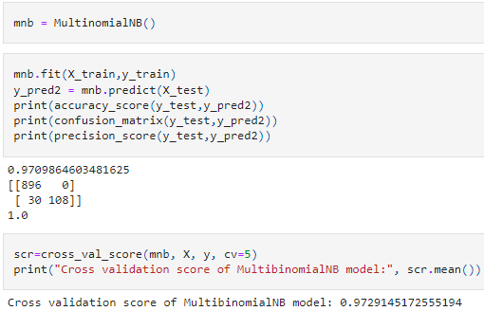
Multibinomial NB
Multibinomial NB have accuracy score as 0.970 and Cross validation score as 0.972.

Slide 20
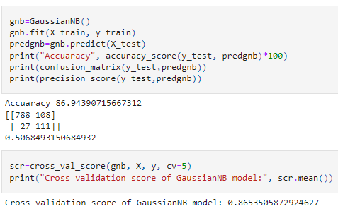
Gaussian NB
Gaussian NB have accuracy score as 86.9 and Cross validation score as 0.865.

Slide 21
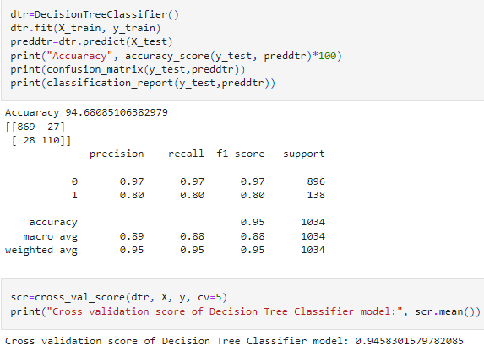
Decision Tree Classifier
Decision Tree Classifier have accuracy score as 94.6 and Cross validation score as 0.94.

Slide 22
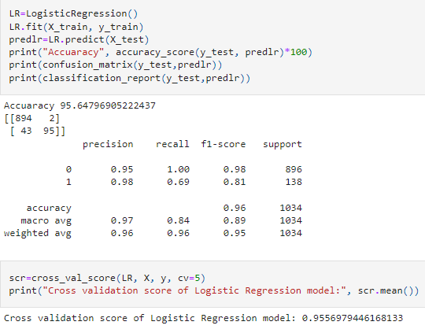
Logistic Regression
Logistic Regression have accuracy score as 95.6 and Cross validation score as 0.95.

Slide 23
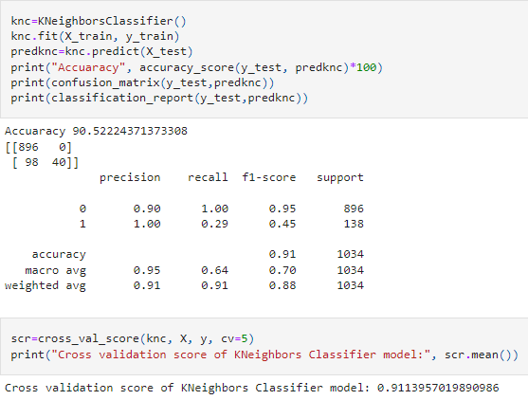
KNNeighbors Classifier
KNN Classifier have accuracy score as 90.5 and Cross validation score as 0.91.

Slide 24
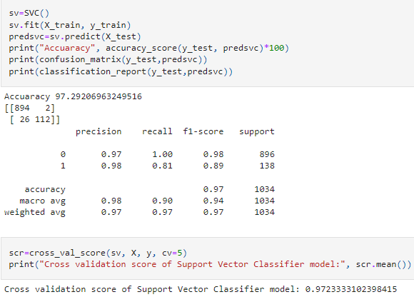
Support Vector Classifier
Support vector classifier have accuracy score as 97.2 and Cross validation score as 0.97.

Slide 25
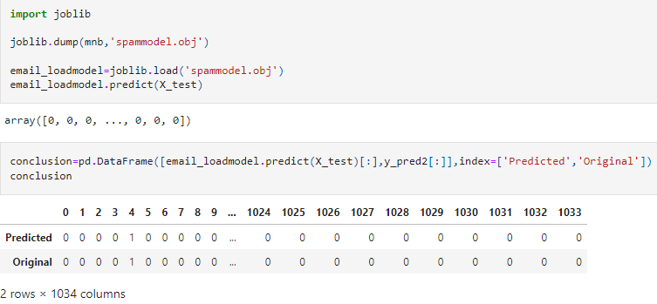
Saving the Model and Predictions

Slide 26
CONCLUSION
This project gives an idea of NLP text processing in machine learning. Apart from applying the techniques that we have learnt in the EDA, we also classified hate and offensive comments so that it can be controlled and restricted from spreading hatred and cyber bullying. From this dataset we were able to understand the idea of Natural Language Processing using machine learning models. This model helps us to understand whether the Email is SPAM or NOT. We have mentioned step by step procedure to analyze the data and checked the correlation between label and feature. After that we saved the model in a pickle with a filename in order to use whenever we require. Then we loaded the saved file and predicted the values for test data.

Slide 27
THANK YOU

